Slide 1
Capstone Project Prediction model of metabolic syndrome in non-obese body population
Sangwoo Lee

Slide 2
Introduction
'Metabolic syndrome’ definition
A set of ‘conditions’ that occur together, increasing risk of cardiovascular disease, diabetes, stroke and other diseases.
Metabolic syndrome is a serious health condition that affects about 23 percent of adults

Slide 3
Introduction
If a person has 3 or more of the 5 conditions,
the person is
metabolic syndrome positive!
↑
HDL cholesterol
(<1.0mmol/L)
Waist circumference ↑
(>38”Men, >35”Women)
Heart disease, lipid problems,
Hypertension, type 2 diabetes,
Dementia, cancer,
Polysystic ovarian syndrome,
Non-alcoholic fatty liver disease
Blood Pressure ↑
(>130/85mmHg)
Blood Triglycerides ↑
(>1.5mmol/L)
Blood sugar (glucose) ↑
(>5.6mmol/L)
HDL cholesterol: high-density lipoprotein cholesterol. A good cholesterol.
Systolic/diastolic
Blood Triglycerides: a type of fat In blood
https://www.cannabizjournal.com

Slide 4
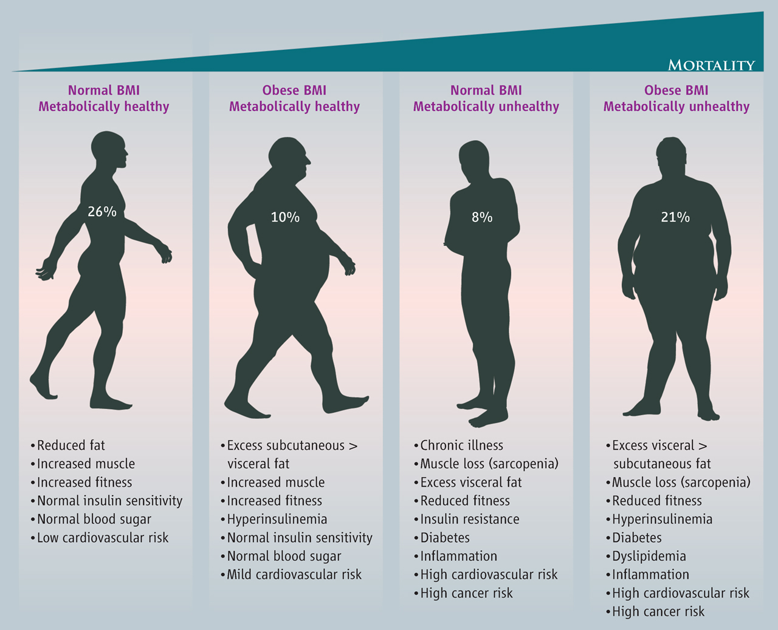
Introduction
EVEN WITH HEALTHY WEIGHTS, PEOPLE CAN HAVE METABOLIC SYNDROME, INCREASING RISK FOR CERTAIN DISEASE AND MORTALITY
Science 2013

Slide 5
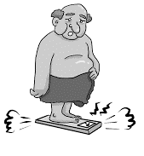
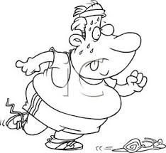




Purpose
I am worried about me
Exercise
Regular check up
I’m Good!
I don’t need exercise
I don’t need a doctor
Metabolic syndrome

Slide 6


Materials and Methods
HER (electronic health records) data of 91,337 persons obtained from health checkups in South Korea
Missing categoric values
Metabolic syndrome
Body mass index < 25 kg/m²
58,380 non-obese population
Class imbalance adjusted
30,953 on the training set(class imbalance adjusted), 17514 on the test set(class imbalance unadjusted)
Logistic regression,
Random forest classification
Clinical information
Model A : age, sex, smoking, alcohol, exercise, BMI
Model B : age, sex, smoking, alcohol, exercise, Height, Weight
Model C : age, sex, smoking, alcohol, exercise, BMI, Height, Weight
Machine learning
Notes:
EHR (Electrical Health Records)

Slide 7
Features
Model A
Model B
Model C
 | input 1 | input 2 | input 3 | input 4 | input 5 | input 6 | input 7 | input 8 | output
 | continuous | categorical | categorical | categorical | categorical | continuous | continuous | continuous | categorical
id | age | sex | smoking | exercise | alchol | Height(cm) | Weight(cm) | BMI(cm) | Metasyn
GC15A1321697346 | 30 | 1 | 0 | 0 | 1 | 168.7 | 33.4 | 11.7 | 0
GC15A6279357334 | 30 | 1 | 0 | 1 | 0 | 152.3 | 35.1 | 15.1 | 0
GC15A8372917126 | 60 | 1 | 0 | 1 | 0 | 158.6 | 38 | 15.1 | 1
GC15A4344463692 | 51 | 0 | 0 | 0 | 0 | 170.7 | 46.6 | 16 | 0
GC15A8329065475 | 59 | 0 | 1 | 1 | 1 | 155.7 | 38.9 | 16 | 1
 | … | … | … | … | … | … | … | … | 0: 84.2% 1: 15.7%
Class imbalance problem
With class imbalance problem, performance was not good
On the training set, oversampling was done on the minority class(=Metasyn pos or 1), followed by downsampling on the majority class(=Metasyn neg or 0).
Best methods and target ratio(pos:neg) was found by trials and errors.
Oversampling: synthetic minority oversampling technique, or SMOTE
Downsampling: random downsampling

Slide 8
Continuous variables
SW

Slide 9
Linearity Assumptions
There is a linear relationship between the logit of the outcome and each predictor variables.

Slide 10
Linearity Assumptions
There is high intercorrelations (i.e. multicollinearity) among the predictors.
sex
smoking
alcohol
exercise
age
BMI
Height
weight

Slide 11
Modeling Results
Classifixcation Model | Feature selection | Test set results |  |  |  |  | Best Hyperparameters (*)
 |  | accuracy | precision | Recall (=sensitivity) | Specificity | F1-score
Logistic Regression | modelA | 0.72 | 0.83 | 0.72 | 0.92 | 0.76 | C: 0.0101, penalty:l1
 | modelB | 0.72 | 0.83 | 0.73 | 0.92 | 0.76 | C: 0.0101, penalty:l1
 | modelC | 0.72 | 0.83 | 0.72 | 0.92 | 0.76 | C: 0.0101, penalty:l1
Random Forest classificatio | modelA | 0.73 | 0.82 | 0.74 | 0.91 | 0.77 | min_samples_split: 28, min_samples_leaf: 2, n_estimators: 50
 | modelB | 0.74 | 0.80 | 0.74 | 0.89 | 0.76 | min_samples_leaf: 1, min_samples_split: 2, n_estimators: 100
 | modelC | 0.74 | 0.80 | 0.74 | 0.89 | 0.77 | min_samples_leaf: 1, min_samples_split: 2, n_estimators: 100
(*) Parameter tuning was done in the best f1 criterion

Slide 12
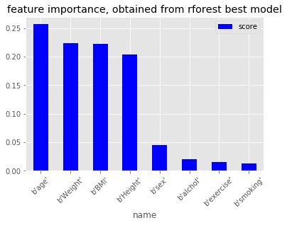
Feature Importance as per Random Forest
age
weight
BMI
height
sex
alcohol
exercise
smoking

Slide 13
Findings and Further Studies
Findings
Using basic health checkup results and machine learning, alerts for metabolic syndromes can be made with high accuracy/sensitivity/specificity/precision/f1-score.
Further studies
Development of a Shiny app
Enter one’s basic information(age….weight, etc) on the Shiny app
Metabolic syndrome alerts can be made
Alerted persons may consult a doctor
Further improvement of overall performance
Clustering
PCA

